Slide 1

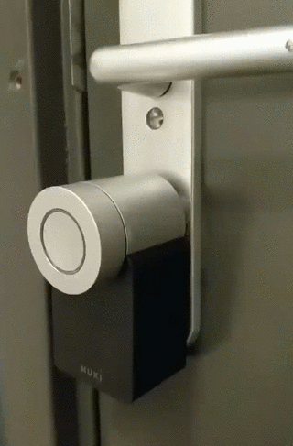
Everything is better with(out) Bluetooth
This presentation is available at https://docs.google.com/presentation/d/1lSReYeUx0t_KwUnmn1NX47ozq8uY5GoZ4xzz0IwlJ3s/

Slide 2

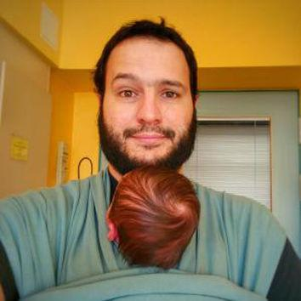
About us
Falko
Full stack tinkerer
Cargo Bike Pimper
Chief (technical) Product Manager at Sensorberg^{Android/iOS dev}
about.me/falkorichter @volkersfreunde
Ronaldo
Android Dev
Raspberry Pi enthusiast
Expert Diaper changer
github.com/budius | @ronaldopace

Slide 3

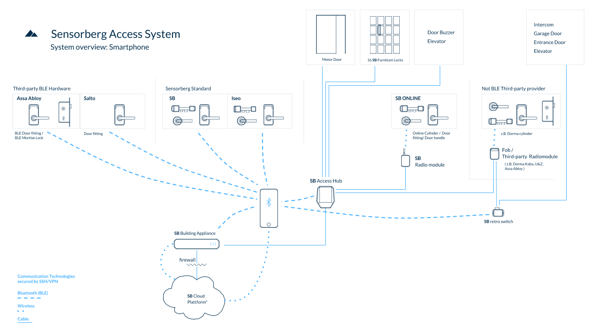
Project Overview
Sensorberg
  Smart Spaces — where people and buildings interact
  Getting into a space is the first interaction
  Of course with your phone!
  Bluetooth LE really is the only common denominator for a reliable connection
    offline capable, fast, reliable*
Interactions currently:
  book a meeting room
  open a locker
  open the entrance
  open a garage
* let´s talk later about reliablity

Slide 4

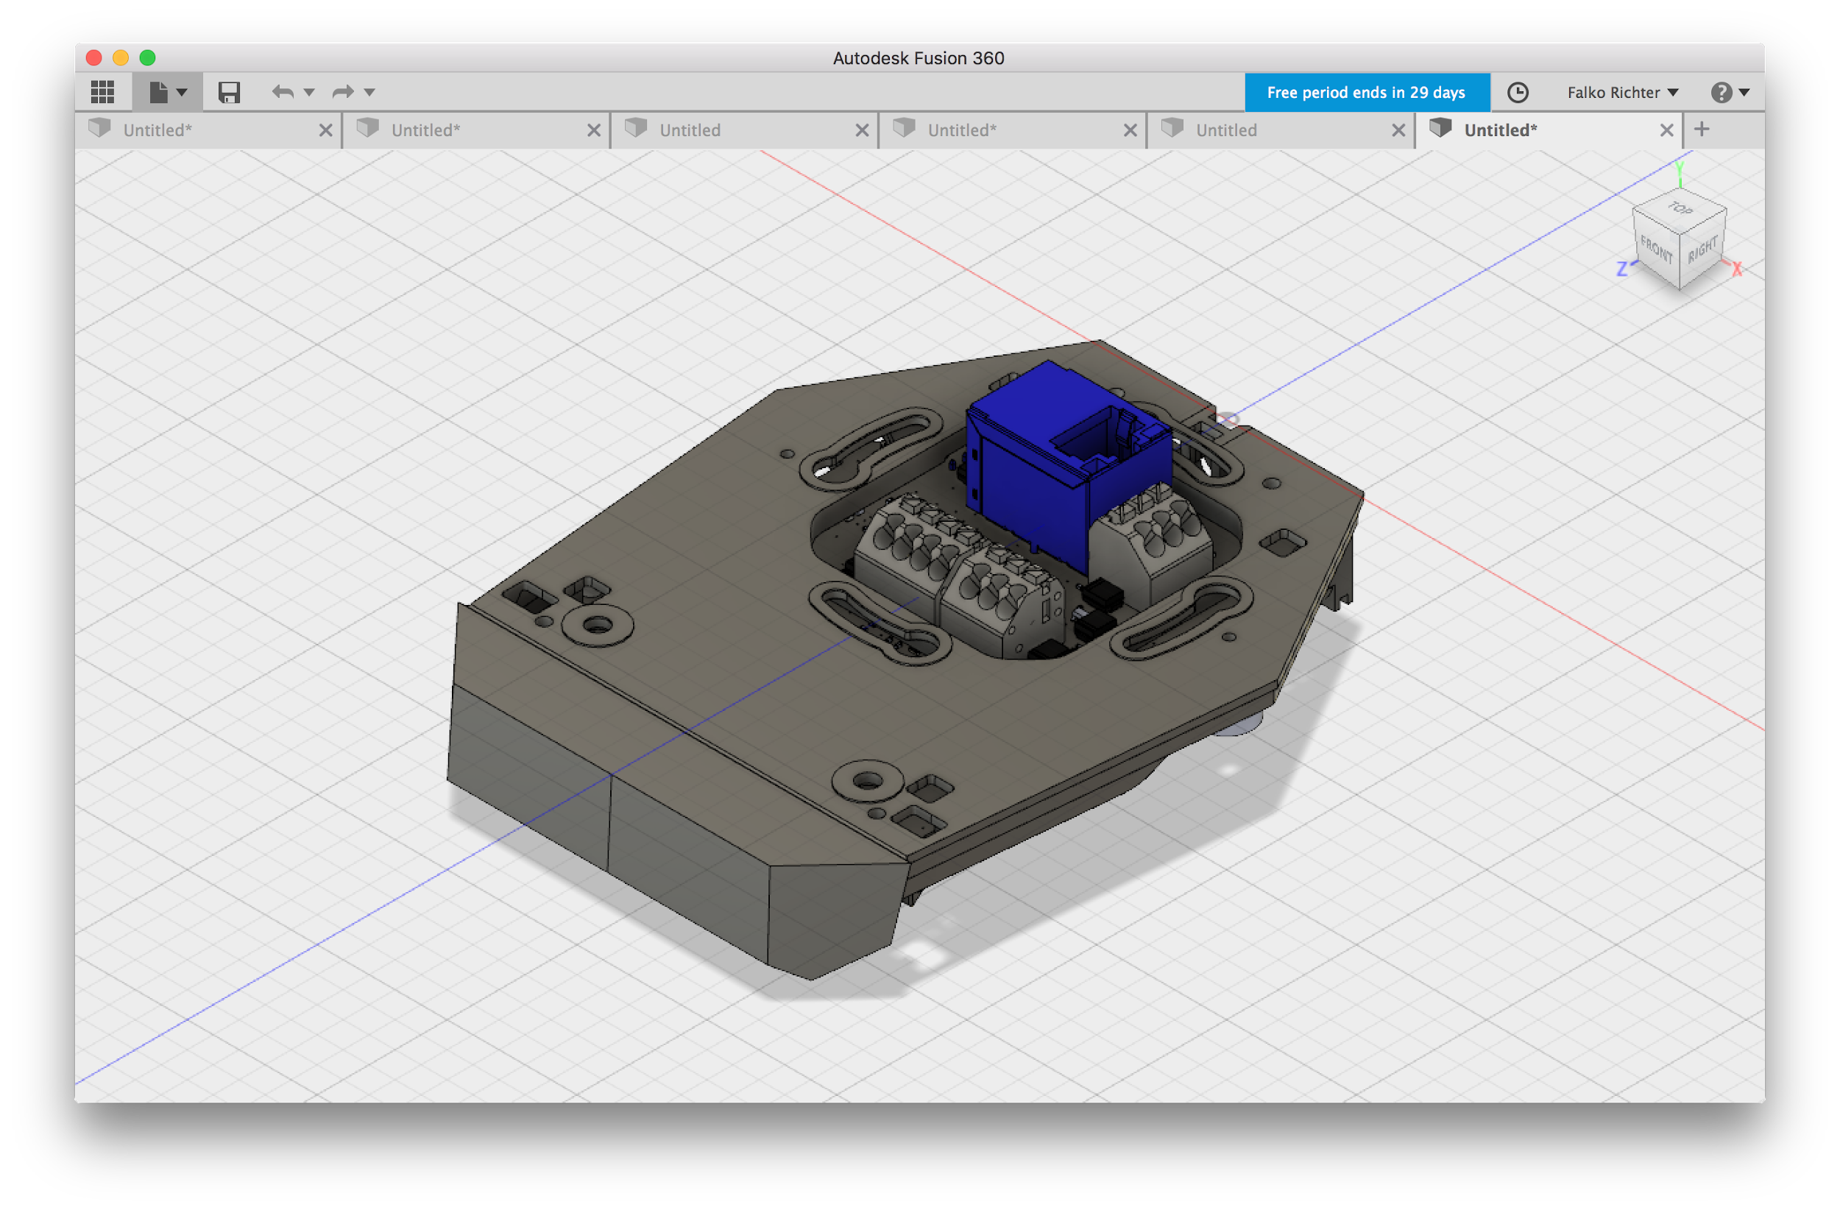
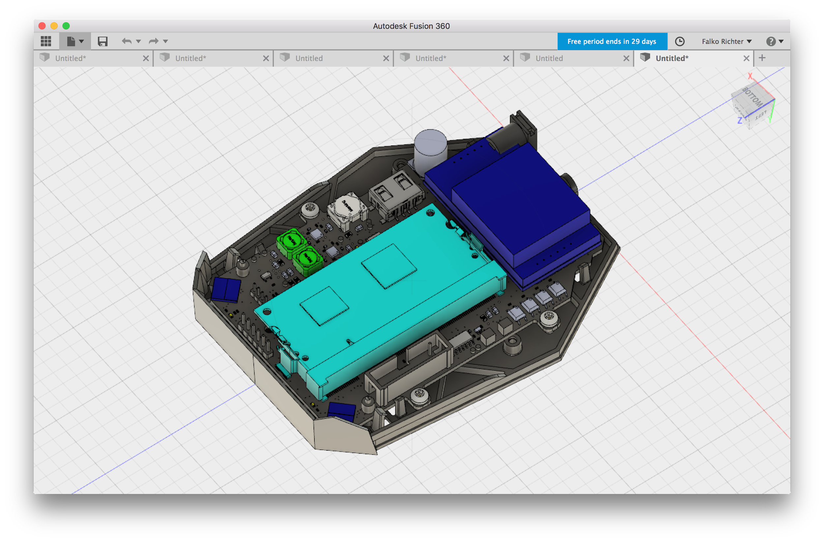
Project Overview
Device needed which has BLE, internet & can open door hardware
  Pi compute Module Platform
  Custom board 100% made in Berlin
  All based on open source software & hardware

Slide 5
BLE - what you should know
GATT (The Generic Attributes (GATT) define a hierarchical data structure that is exposed to connected Bluetooth Low Energy (LE) devices)
  Service
    Group of Characteristics
  Characteristic
    Write/ Read /Subscribe
    has a UUID
Descriptions availble on bluetooth.com
  https://www.bluetooth.com/specifications/gatt
  you can also make up your own!

Slide 6
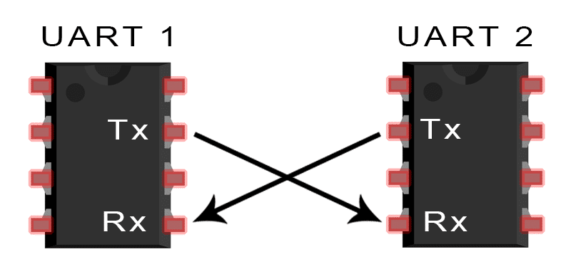
Project Overview - universal bluetooth communication
UART/Serial Port Emulation over BLE
open source / standard by nordic
https://learn.adafruit.com/introducing-adafruit-ble-bluetooth-low-energy-friend/uart-service
  find (by Service)
  connect
  discover
  subscribe to Rx
  write to Tx Request
  wait for answer on Rx Response
  disconnect
https://infocenter.nordicsemi.com/index.jsp?topic=%2Fcom.nordic.infocenter.sdk5.v14.0.0%2Fble_sdk_app_nus_eval.html

Slide 7

Challenge
Open a door/locker/garage as fast as possible
~ 0.5 million bluetooth connects (both platforms) add up to a lot of (potentially wasted) lifetime

Slide 8
How to Bluetooth-LE Scan
private val bleScanner = BluetoothAdapter.getDefaultAdapter().bluetoothLeScanner
override fun onStart() {
super.onStart()
bleScanner.startScan(callback) // optional scan filters and scan settings
}
override fun onStop() {
bleScanner.stopScan(callback)
super.onStop()
}
private val callback = object : ScanCallback() {
override fun onScanResult(callbackType: Int, result: ScanResult) {
Log.d("MyApp", "onScanResult: $result. rssi: ${result.rssi} dB")
}
}

Slide 9
How to Bluetooth-LE GATT communication
if (isRightDevice(result)) result.device.connectGatt(context, false, gattCallback)
private val gattCallback = object : BluetoothGattCallback() {
override fun onConnectionStateChange(gatt: BluetoothGatt, status: Int, newState: Int) {
if (isConnected(status, newState)) gatt.discoverServices()
else gatt.close()
}
override fun onServicesDiscovered(gatt: BluetoothGatt, status: Int) {
val gattCharacteristic = gatt.getService(serviceUuid).getCharacteristic(characteristicWrite)
gattCharacteristic.value = "open door"
gatt.writeCharacteristic(gattCharacteristic)
}
override fun onCharacteristicWrite(gatt: BluetoothGatt, characteristic: BluetoothGattCharacteristic, status: Int) {
val gattCharacteristic = gatt.getService(serviceUuid).getCharacteristic(characteristicRead)
gatt.readCharacteristic(gattCharacteristic)
}
override fun onCharacteristicRead(gatt: BluetoothGatt, characteristic: BluetoothGattCharacteristic, status: Int) {
if(characteristic.value == "door opened") { /* success !!! */ }
gatt.disconnect()
}
}

Slide 10
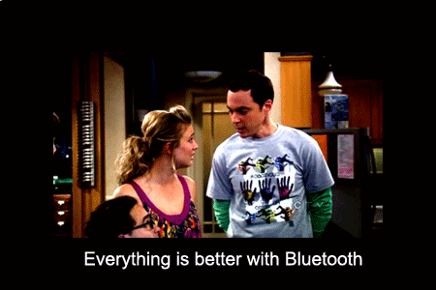
(OUT)

Slide 11
Everything is better with(out) Bluetooth
… scanning
BluetoothAdapter.getDefaultAdapter().startLeScan(scanCallbackV18)
Some devices doesn’t support certain scan settings parameters
Some devices doesn’t support scan filters
  Some devices say they support scan filters, but result on callback never called
Workaround:
  Use Nordic Scanner compat
  https://github.com/NordicSemiconductor/Android-Scanner-Compat-Library
  // disable hardware filtering
  .setUseHardwareFilteringIfSupported(false)

Slide 12
Everything is better with(out) Bluetooth
… scan callback
override fun onScanResult(callbackType: Int, result: ScanResult) {
On some devices is called for every scan
on others, only on the first time a BLE device is scanned
Workaround is to startScan/stopScan every second
Starting on Android Nougat Developer Preview 4
> We’ve changed the BLE Scanning behavior starting in DP4. We’ll prevent applications from starting and stopping scans more than 5 times in 30 seconds. For long running scans, we’ll convert them into opportunistic scans.
  Sources:
    https://web.archive.org/web/20160820074825/https://developer.android.com/preview/support.html#dp4
    https://android-review.googlesource.com/c/platform/packages/apps/Bluetooth/+/215844/15/src/com/android/bluetooth/gatt/AppScanStats.java#144

Slide 13

Everything is better with(out) Bluetooth
… scan callback
override fun onScanFailed(errorCode: Int) {
// SCAN_FAILED_APPLICATION_REGISTRATION_FAILED
// SCAN_FAILED_INTERNAL_ERROR
}
Workaround:

Slide 14
Everything is better with(out) Bluetooth
… scan callback
private val scanCallback = object : ScanCallback() {
override fun onScanResult(callbackType: Int, result: ScanResult) {
scanResults[result.device.address] = result
private fun openClosest() {
val scanList = scanResults.values.filter { it.rssi >= threshold }.sortedBy { it.rssi }
open(scanList[0])
}
rssi variance
  time dependent weighted moving average https://github.com/sensorberg-dev/motionless-average
on device learning of threshold variance
  start with a permissive default
  adjust with a moving average of the rssi during successful connection
  offset a few decibels for actual filtering

Slide 15
Everything is better with(out) Bluetooth
… GATT communication
`result.device.connectGatt(...)` only works if called from UI-thread
  on some devices
override fun onConnectionStateChange(gatt: BluetoothGatt, status: Int, newState: Int) {
if (newState != BluetoothGatt.STATE_CONNECTED) // connect again
override fun onCharacteristicWrite(gatt: BluetoothGatt, characteristic: BluetoothGattCharacteristic, status: Int) {
override fun onCharacteristicRead(gatt: BluetoothGatt, characteristic: BluetoothGattCharacteristic, status: Int) {
  if(status != GATT_SUCCESS) // retry
  if (status == 133)
    Source code:
    #define GATT_ERROR 0x0085

Slide 16
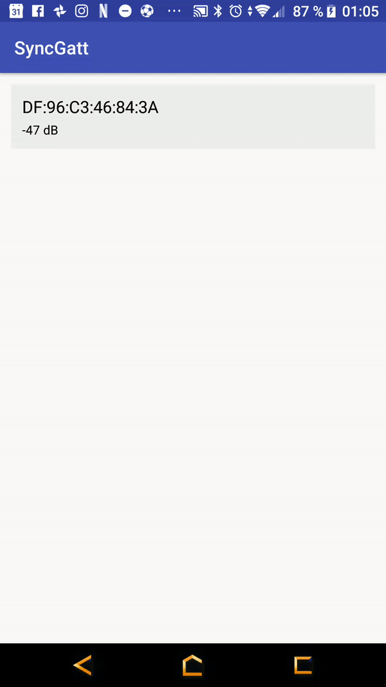

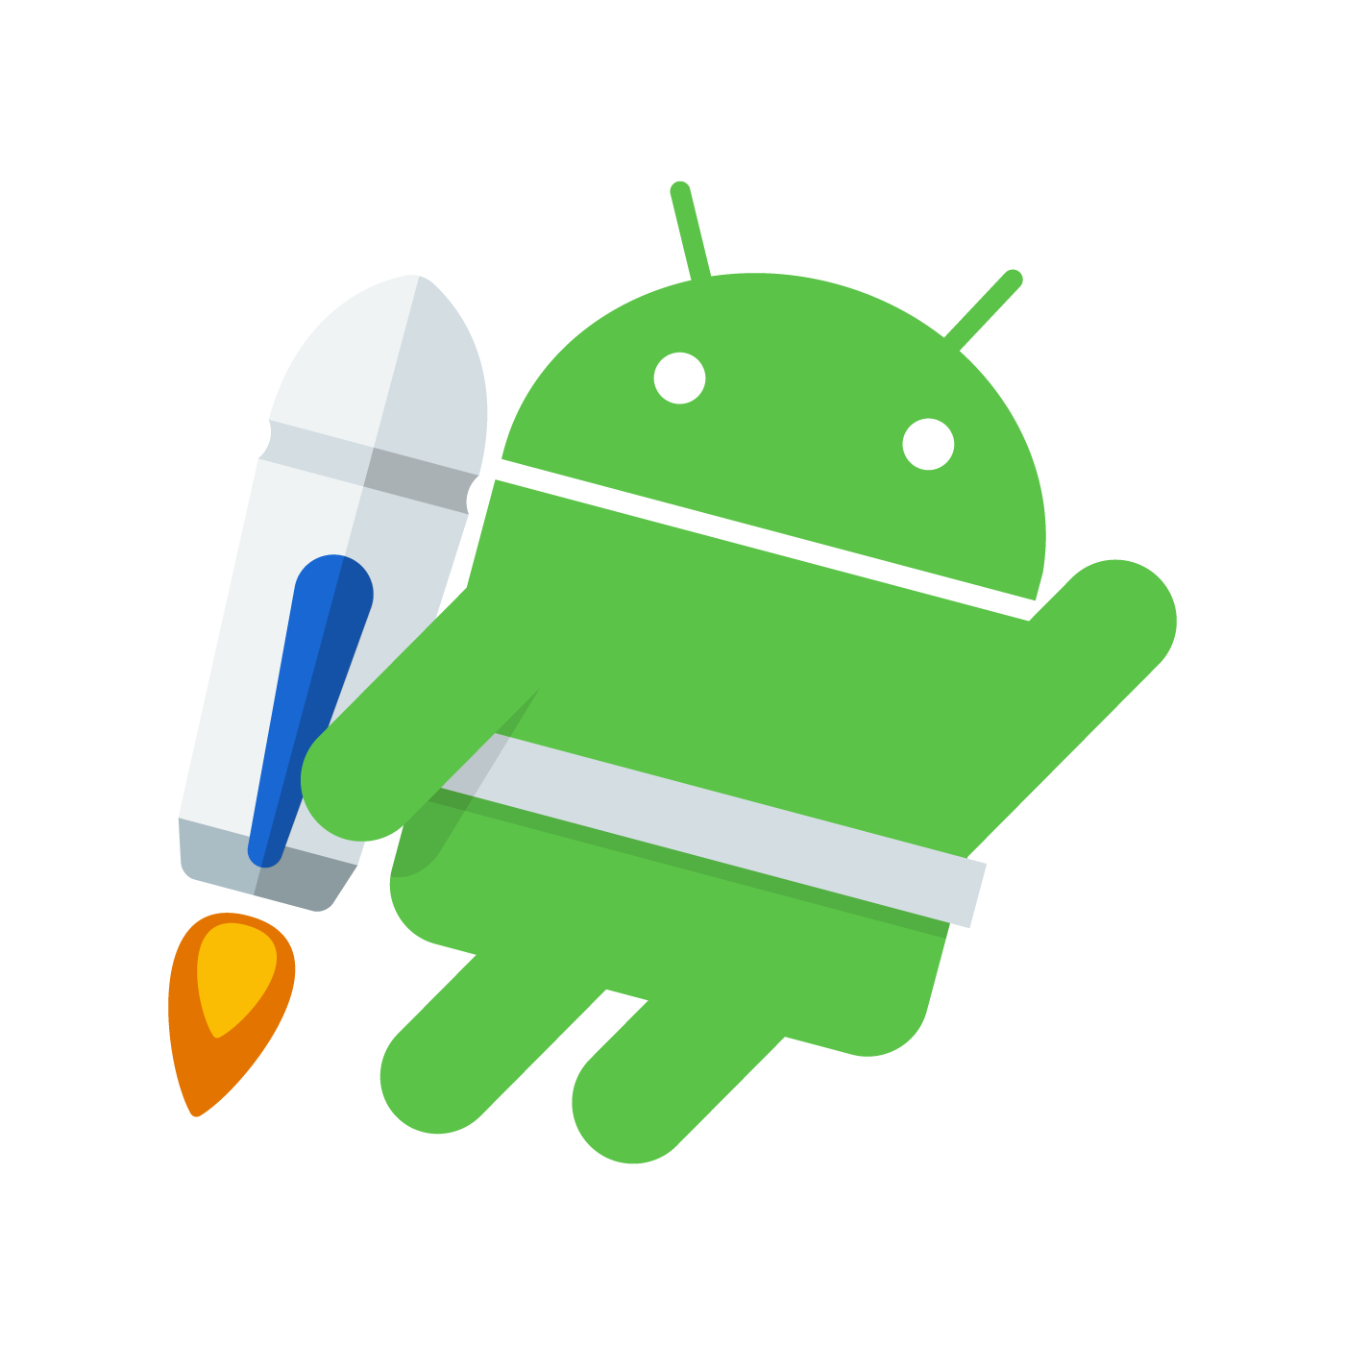
Everything is better with(out) Bluetooth
… GATT communication
Asynchronous callback based API
Thread {
SynchronousGatt(scanResult.device).apply {
connectGatt(this@MainActivity, false, 10000)
discoverServices(3000)
val notify = bluetoothGatt.getService(serviceUuid)
.getCharacteristic(characteristicRead).getDescriptor(descriptorNotify)
notify.value = enableNotify
writeDescriptor(notify, 3000)
val writeCharacteristic = bluetoothGatt
.getService(serviceUuid).getCharacteristic(characteristicWrite)
writeCharacteristic.setValue("open door")
writeCharacteristic(writeCharacteristic, 3000)
val changed = awaitCharacteristicChange(5000)
if (changed.characteristic.getStringValue(0) == "door opened") sucess()
disconnect(1000)
} }.start()
connect
discover
subscribe
write (x N)
await

Slide 17
Everything is better with(out) Bluetooth
… after much hacking
Scanning:
  NordicScannerCompat
  ScannerStartStop
  ScannerNougat
  Averaging algorithms
  Did you try turn off and on again?
Communicating:
  Synchronous API
  Retry on random fail
  Retry on random disconnection
  Did you try turn off and on again?

Slide 18
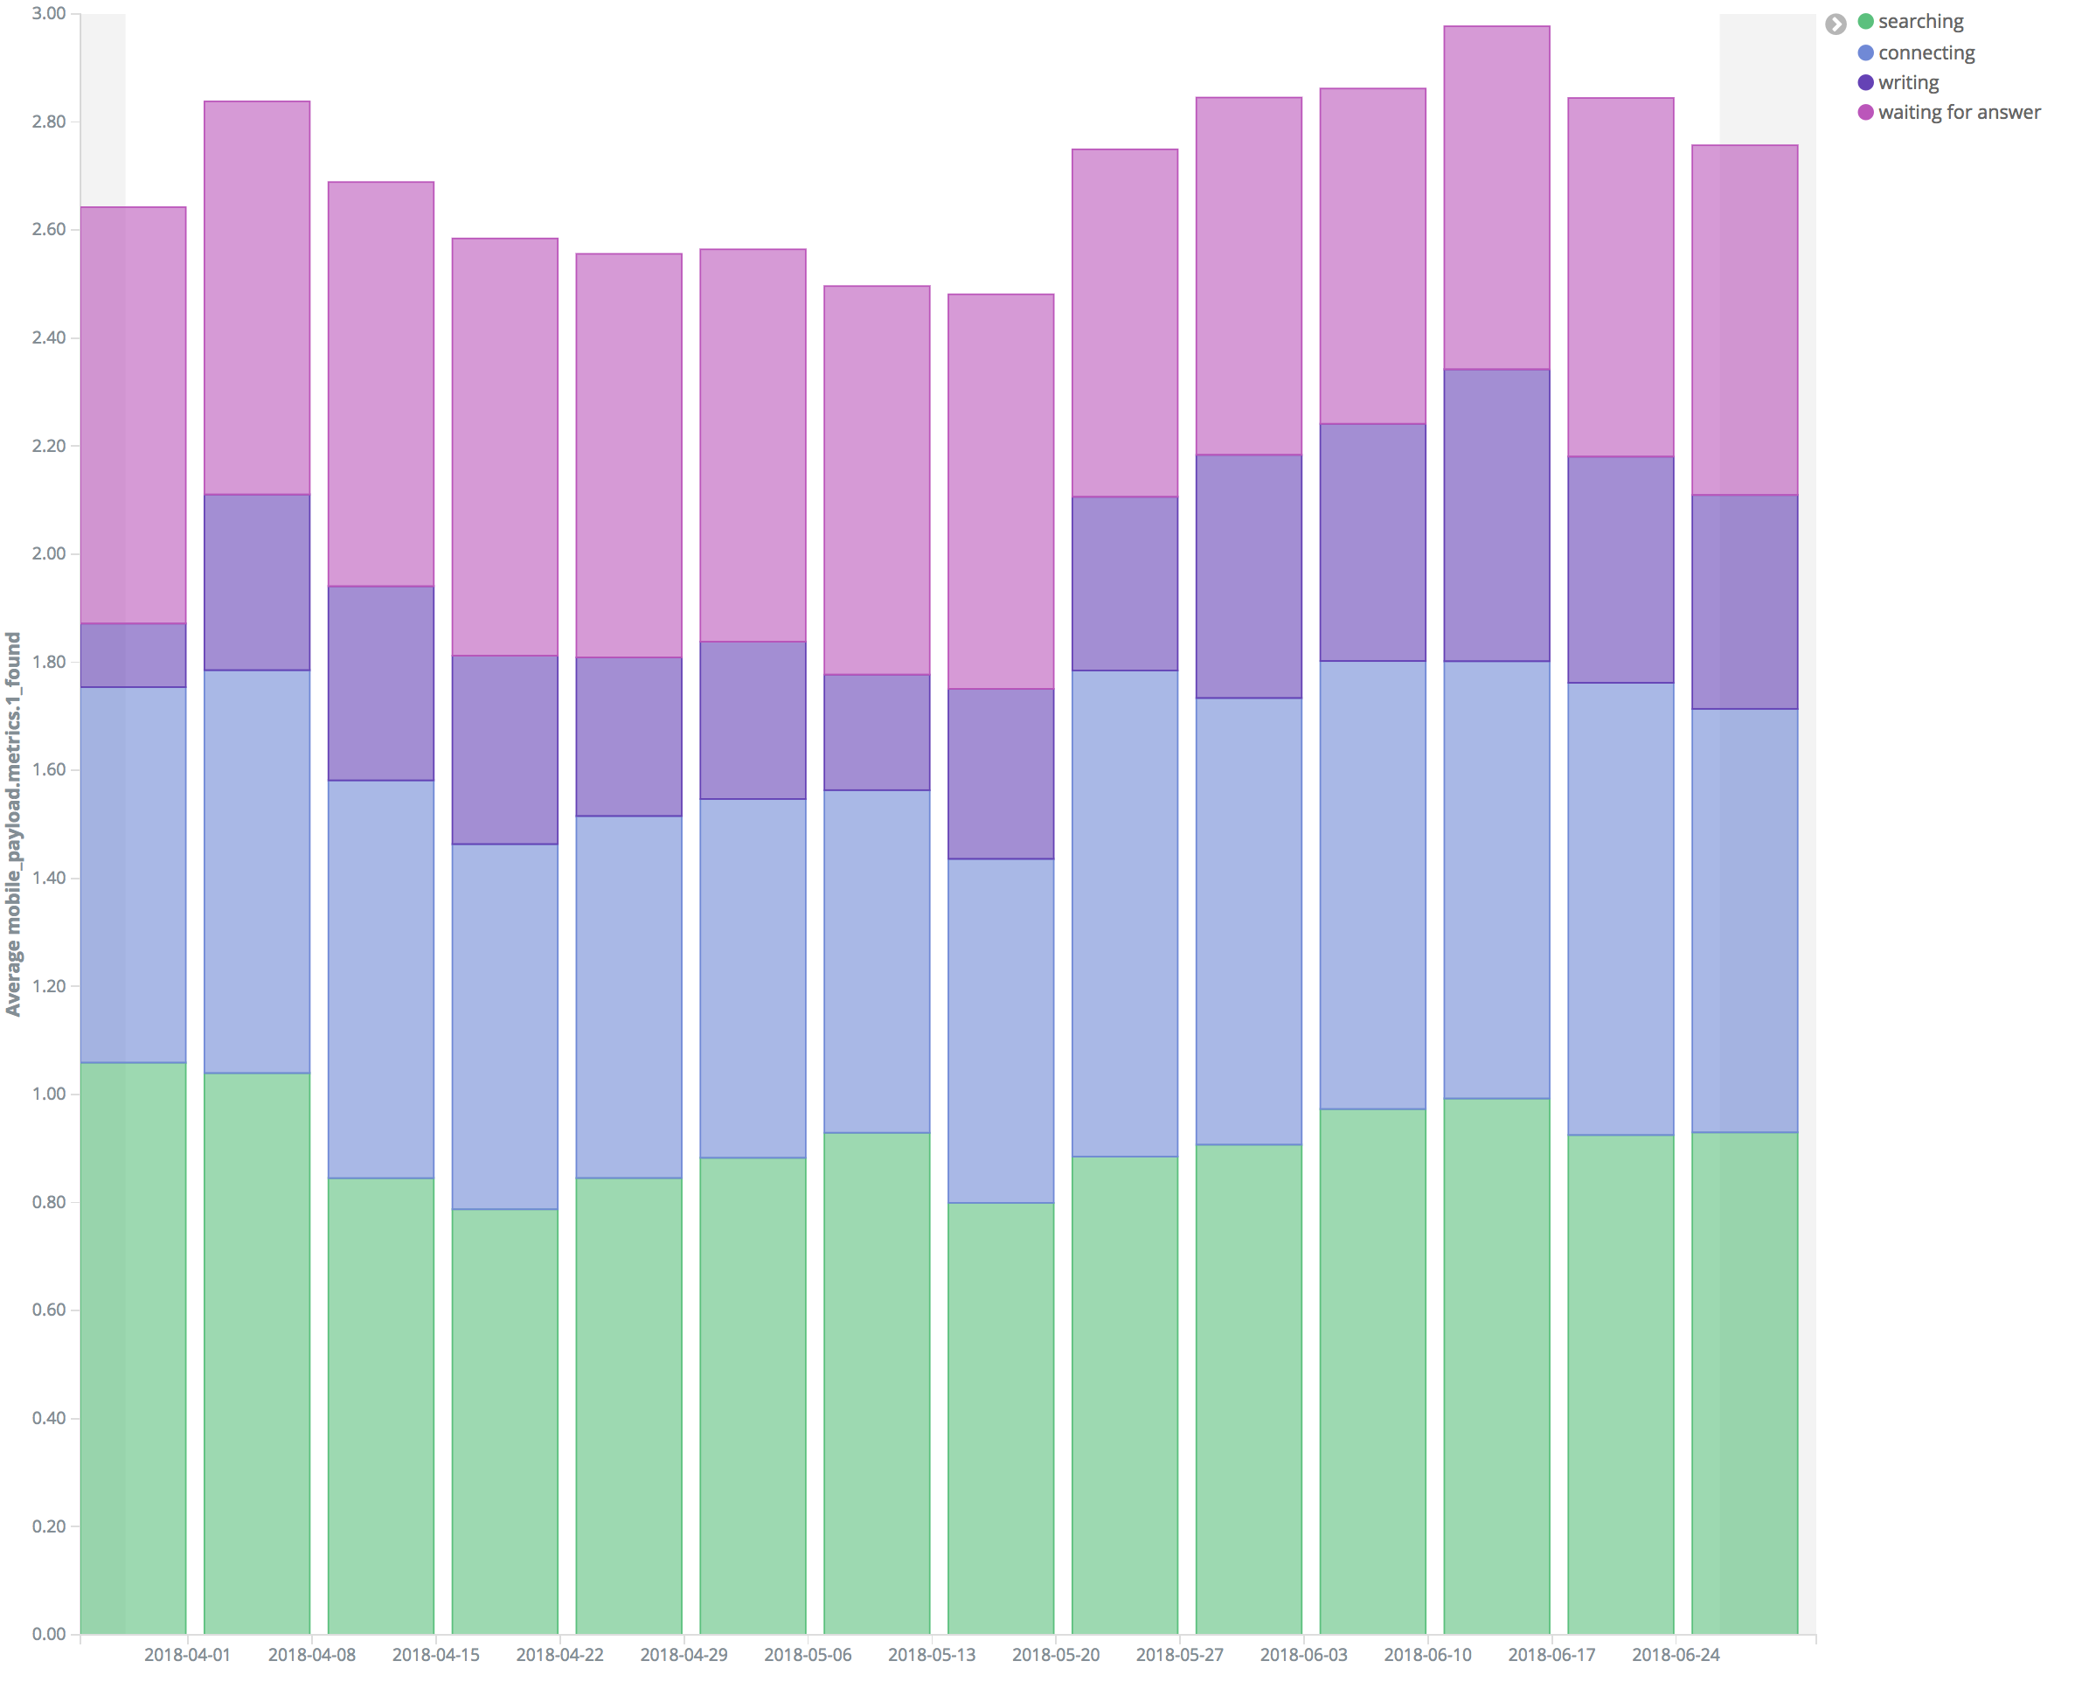
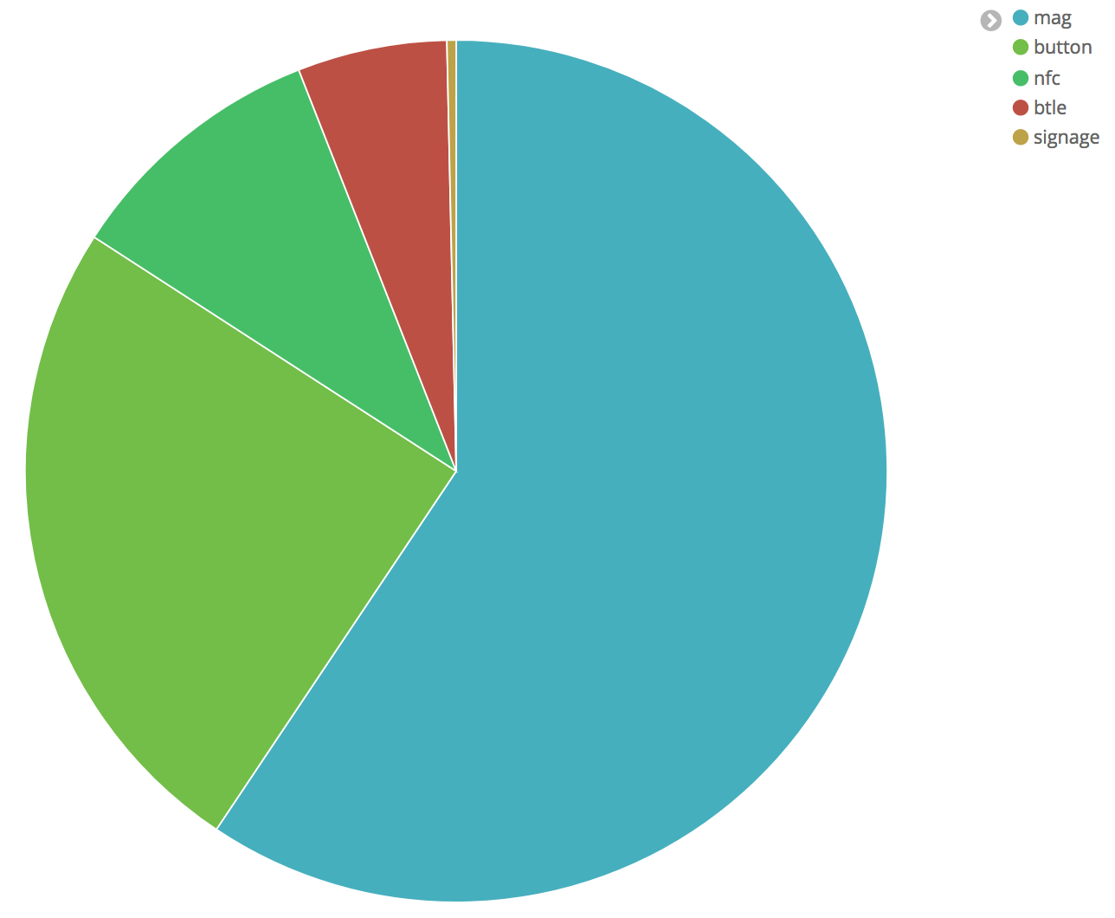
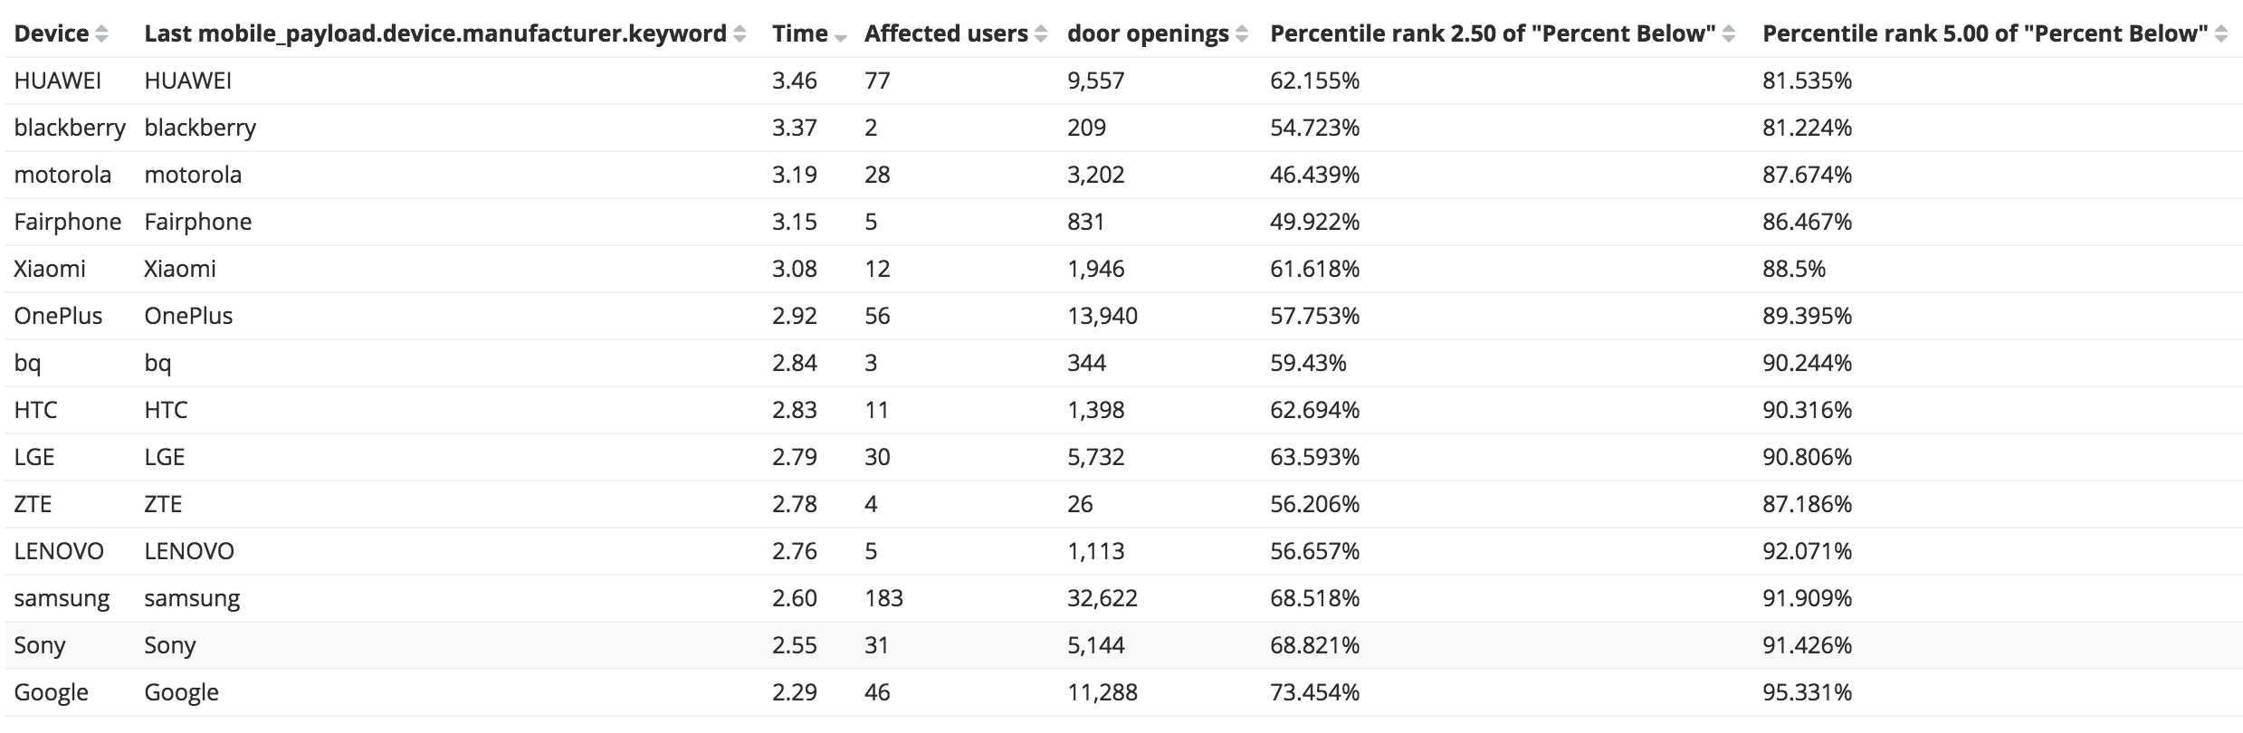
Data
~⅓ time is wasted trying to find the right device
Google is the best manufacturer (74% of access requests under 2.5s)
manufacturers ordered by average opening time
at least 2 users

Slide 19
Data
@POST("/")
@Headers("Content-Type: application/json")
Call<String> pushStatistics(@Body Stats stats);
Firebase is not enough
  not realtime
  no filtering
  aggregations are to limited
Elasticsearch to the rescue
  account: 2 minutes https://www.elastic.co/cloud/elasticsearch-service/signup
  post JSON to your [...].aws.cloud.es.io:9243/{index}/mobile_statistics
  simple rules for data integrity
    never change a type (String becomes Number, String becomes Object)
    lower case all strings / remove spaces
    add UUIDs/hashes so you can count devices / users
    one index per deployment (production / staging)
  leave out personal data
  delete indexes (buckets) regularly

Slide 20
Data
hack some visualizations in Kibana
combine visualizations to powerful interactive dashboards
metrics to find fragmented devices:
  BuildConfig.VERSION_CODE
  BuildConfig.VERSION_NAME
  BuildConfig.APPLICATION_ID
  Build.VERSION.SDK_INT
  Build.MODEL
  Build.MANUFACTURER

Slide 21
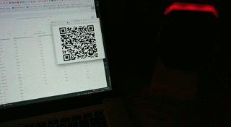
… how to avoid bluetooth
Hybrid detection and communication
  Detection
    Bluetooth (“This BTLE device is so close, I should connect to it”)
    NFC (nfc://connect/to/DF:96:C3:46:84:3A)
    Optical?!
    (magnetic) tap detection
  communication (try all, winner takes it all)
    Bluetooth
    HTTPS via wifi/cellular
    NFC (in the next generation of the hardware)
    synchronize with a request ID in backend or on access hub

Slide 22


Testing
LEGO train #ftw
  get the (not sold anymore) powered tracks (no battery)
  use two power modules for reliability - it will make the train go reliably slow!
    Schwerlastzug 60098 is great
You need to physically test it!
  real devices
  actual Bluetooth hardware
  use your statistics to verify the performance
  Long term testing
Parameters
  speed
  distance to device
  additional sensor to detect phone position
  power the train from the access hub => full control

Slide 23
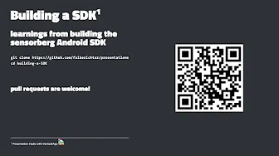
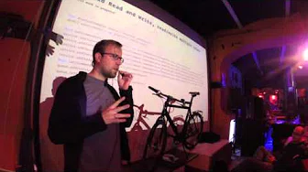
Thx & Sensorberg Open Source:
https://github.com/sensorberg-dev/permission-bitte
https://github.com/sensorberg-dev/motionless-average
https://github.com/sensorberg-dev/EasyIPC
https://github.com/sensorberg-dev/gradle-scripts
https://github.com/sensorberg-dev/android-sdk
soon: https://github.com/sensorberg-dev/synchronous-gatt
We will of course make an SDK from this as well https://www.youtube.com/watch?v=rLuBxsLot5U
Another Bluetooth related GDG talk^{by Falko} https://www.youtube.com/watch?v=OSJ8gIPnvDw

